Slide 1
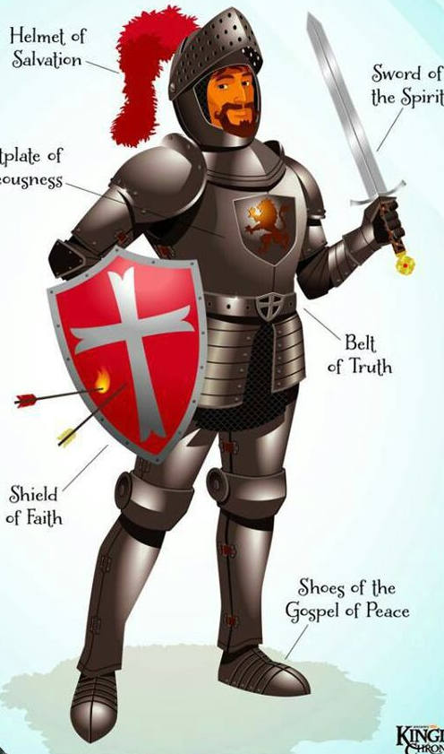
PUT ON THE FULL ARMOR OF GOD
11 Put on the full armor of God, so that you can take your stand against the devil’s schemes.
12 For our struggle is not against flesh and blood, but against the rulers, against the authorities, against the powers of this dark world and against the spiritual forces of evil in the heavenly realms.

Slide 2
PUT ON THE FULL ARMOR OF GOD
13 Therefore put on the full armor of God, so that when the day of evil comes, you may be able to stand your ground, and after you have done everything, to stand.

Slide 3
PUT ON THE FULL ARMOR OF GOD
14 Stand firm then, with the belt of truth buckled around your waist, with the breastplate of righteousness in place,
15 and with your feet fitted with the readiness that comes from the gospel of peace.

Slide 4
PUT ON THE FULL ARMOR OF GOD
16 In addition to all this, take up the shield of faith, with which you can extinguish all the flaming arrows of the evil one.
17 Take the helmet of salvation and the sword of the Spirit, which is the word of God.

